Slide 1
Choose Your Own HTML Adventure
Making on the Web

Slide 2
Storyboard
The first step is to plan your adventure.
Who is the main character?
Where is the story set?
What scenarios will they find themselves in?

Slide 3
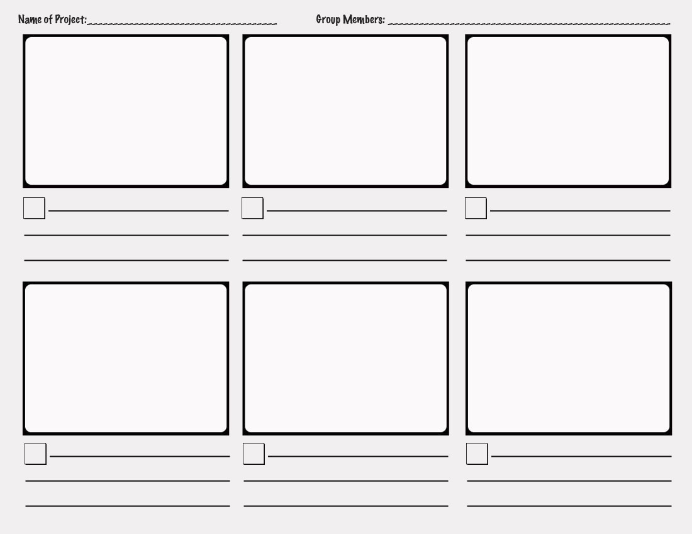

Slide 4
Mind Map
Another great way to organise your thoughts is to use a mind map.
Group similar ideas together
Use colours where appropriate

Slide 5
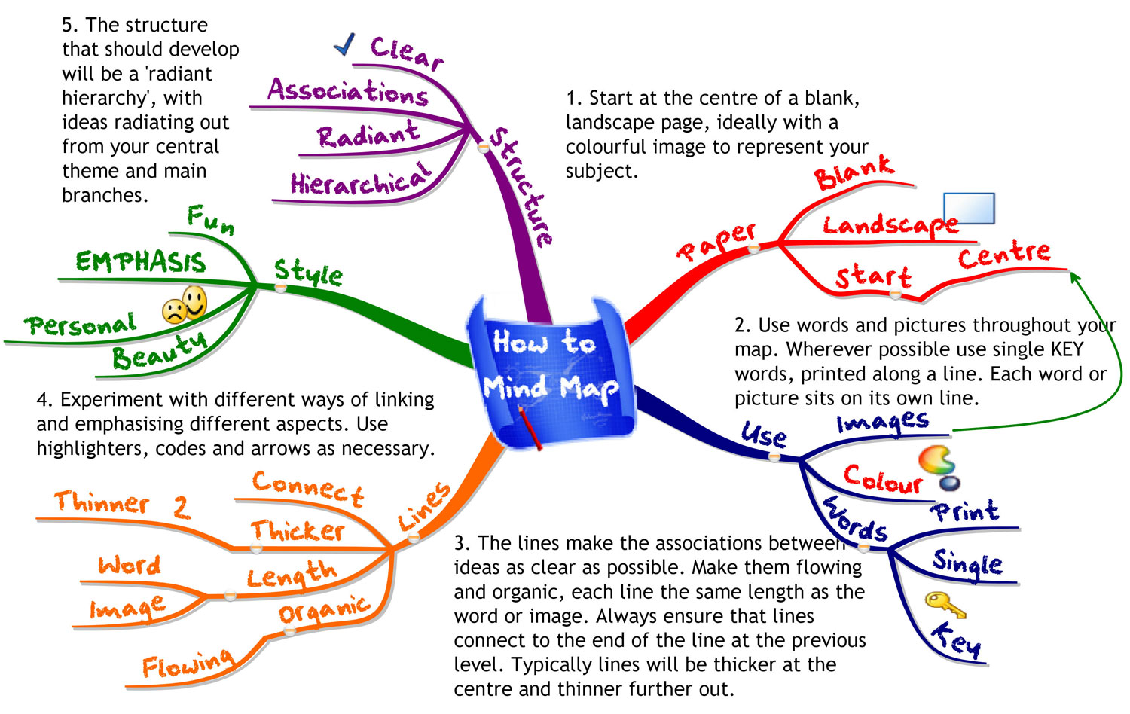

Slide 6
Hierarchy
Finally, you want to translate all these analog ideas into digital files for your project.
Choose a simple, logical system for laying out your files.
In the first example the first digit represents the level of each chapter.

Slide 7
Hierarchy
Chapter1.html
Chapter21.html
Chapter22.html
Chapter31.html
Chapter32.html
Chapter33.html
Chapter34.html

Slide 8
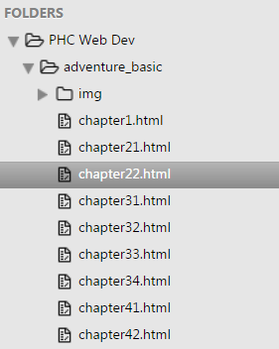
In Sublime Text
In Sublime Text your project will be arranged something like the tree-view on the right.

Slide 9
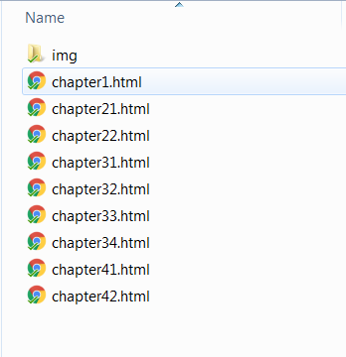
On Windows
When organising your project on a Windows computer you can start by putting all the files in the same directory.
Are there any potential drawbacks to this system?

